Slide 1


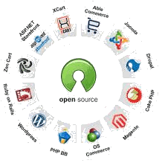
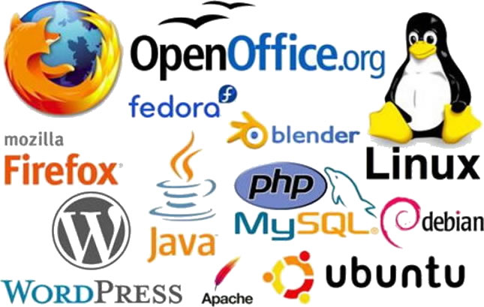
Open Source
Solutions for SMEs
Focus:
Scalable Development
Collaboration
Remote
Productivity
Community
Software redistribution

Slide 2

Open Source
Solutions for SMEs
Who I am
LeROIFOPESON
Information Systems & Technology Consultant
Linux Professional Institute (LPI-2) Certified
Used MS/PC DOS, Windows 3, 95, 98, XP & 7
(XP was my favorite)
Switched to Linux
Abimbola Adefope

Slide 3
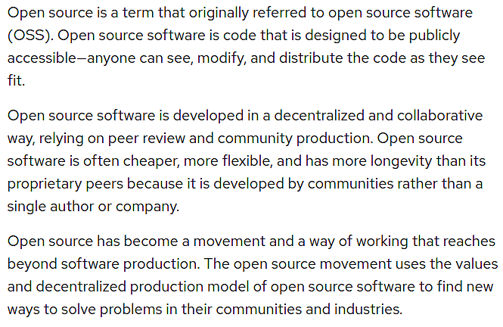
Open Source
Solutions for SMEs
What is Open Source?
Source:
redhat.com

Slide 4
Open Source
Solutions for SMEs
Why use Open Source?
OPEN SOURCE
FREE – No initial cost of acquisition, available to download from the internet
Liberal licenses permit copying and reinstallation on multiple computers
Secure and robust due to continuous peer review of source code
Large community support
Regular updates
Lower total cost of ownership
PROPRIETARY
Pre-installed software on new computer systems are usually proprietary
Proprietary licenses do not permit copying and reinstallation and are therefore more expensive
Updates are according to corporate schedule
New versions may require additional expenditure

Slide 5
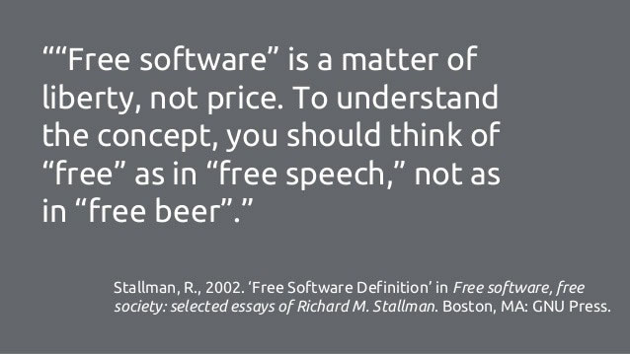
Open Source
Solutions for SMEs
Open Source, free?
Well, usually…
The freedom guaranteed by most Open Source licenses is the freedom to copy , modify and even sell the modified code for profit, provided the new product retains the original license.

Slide 6
Open Source
Solutions for SMEs
Examples of Open Source products
Whatever software your business needs will have an equivalent open source version.
OfficeSoftware: LibreOffice, OpenOffice.org, Abiword
Accounting Software: Wave, ZipBooks, GNUCash
Project Management: OpenProject, Odoo, ProjectLibre
Desktop Publishing: Scrbus, LibreOffice Draw, OpenOffice, Scalar
Computer Aided Design: FreeCAD, LibreCAD, QCAD
Video Editing: KDEnlive, Avidemux, Open Shot, Blender Velvets
Audio Editing: Audacity, Ardour, LMMS
2D /3D Modeling & Animation: Blender, Tupi Tube
Graphics design: Inkscape, GIMP, Krita
Multimedia Players: VLC, SMPlayer, Mixxx
Windows OS: Linux OS
(Start your own) Online Shopping sites: Opencart, ZenCart, Presta Shop

Slide 7
Open Source
Solutions for SMEs
Open Source products sources
A list of the most popular websites for open source products.
Sourceforge.net
FossHub.com
GitHub.com
Bitbucket.org
project.tuxfamily.org
launchpad.net
openhub.net
opensourcesoftwaredirectory.com
alternativeto.net
help.ubuntu.com/community/ListOfOpenSourcePrograms - includes Windows software
f-droid.org – For Android

Slide 8

Open Source
Solutions for SMEs
Linux … spoilt for choice, really…
Beginner:
Zorin OS
Elementary OS
Linux Lite
Kubuntu
deepin
Easy transition from Windows
Intermediate:
Linux Mint
Ubuntu
MX Linux
Manjaro
Debian
More productivity enabled default settings
Advanced:
Arch
Gentoo
Slackware
CentOS
Fedora
Sparse default settings for fully configurable OS

Slide 9

Open Source
Solutions for SMEs
Using Linux
Installation:
Download ISO image file from the relevant website
Write image to USB Flash drive
Boot computer system with flash drive
Choose to try out the Live Linux distro or install to the computer system
Follow the prompts during the process
Reboot
Voila! Linux installed and running on system…just like Windows!
Depending on the choices made during this process, the computer system may be configured to be a server, a workstation or both.

Slide 10
Open Source
Solutions for SMEs
Benefits of using Linux
Lightweight manages memory efficiently
Unix-based, therefore extremely stable, powerful and secure
Practically Immune to computer viruses and malware
Large repository of applications software for productivity
Can be configured to specification as a server or workstation
Can be configured to replace proprietary servers or workstations
Updated frequently for stability
Most experienced computer users will become comfortable with the Linux environment very quickly, because its still point & click once the desired application is running

Slide 11
Open Source
Solutions for SMEs
Open Source in Software Development
Open source tools are the primary tools for developing for the web and for building mobile apps.
Systems software development is done with C, C++ and other high level programming languages, sometimes with Python or Perl.
Some popular open source tools for development;
Languages: Javascript, PHP, Python, Rerl, Ruby, Android
Frameworks: Angular, NodeJS, Ruby on Rails, React, Vue, Bootstrap
Tools: Git, Docker, Sublime Text editor
Databases: MongoDB, MySQL, PostgreSQL
CMS: WordPress, Drupal, Joomla
Development Stacks: AMP, APP, MEAN, MERN

Slide 12
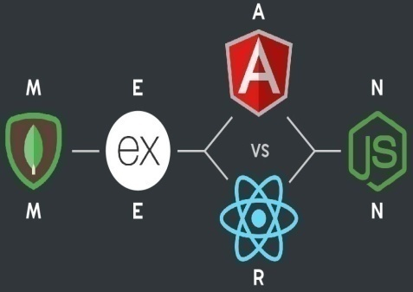

Open Source
Solutions for SMEs
Open Source Software Development Stacks
A Stack refers to a core set of tools which are required to develop a fully functional software application.
Examples:
AMP Stack – Apache, MySQL, PHP (Python or Perl)
APP Stack : Apache, PostgreSQL, PHP (Python or Perl)
MEAN Stack: MongoDB, ExpressJS, Angular, NodeJS
MERN Stack: MongoDB, ExpressJS, React, NodeJS
CMS Stacks: WordPress, Drupal or Joomla + MySQL
AMP & APP are commonly referred to as LAMP, MAMP, LAMP or LAPP stacks depending on the underlying operating system, Linux or Microsoft Windows, in development.

Slide 13

Open Source
Solutions for SMEs
Focus: The MEAN Stack
A web application consists of:
1. Frontend – User Interface(UI)
2. Backend – API Server + Database Server
Same skill set required for frontend and backend developers
Javascript
Frontend developers develop the user interface [Angular] to the application on the server
Backend developers develop the Application Programming Interface (API) [NodeJS & Express] on the server which queries a database server [ MongoDB ], in response to user requests

Slide 14
Open Source
Solutions for SMEs
Focus: The MEAN Stack - Scalability
A simple setup:
Download the version of Bitnami MEAN Stack from bitnami.com/stack/mean/installer for your operating system and install it.
This install NodeJS and MongoDB in on the computer.
Angular is added by following the instructions at angular.io/cli
Instructions for installing ExpressJS are at expressjs.com.
This setup enables the MEAN stack environment, only when needed.
In the cloud:
This setup can be scaled to the cloud through the Microsoft Azure Cloud Services, which provides a service that hosts the Bitnami MEAN stack online.
There are alternatives to this installation process. See turnkeylinux.org

Slide 15

Open Source
Solutions for SMEs
Focus: The MEAN Stack - Collaboration
Git Distributed Version Control System (git-scm.com)
Open source, free, secure & OS agnostic
Remote collaboration between users while preserving code integrity
Creates history of software development progress
Works with GitHub, Bitbucket
Use scenario:
Each team member has a local installation of the MEAN stack for development. Database may be shared on the web or local.
Using Git, updates of code are labeled and pushed into a common Git repository (GitHub) .
Team coordinator collates, reviews and merges updates with the main version of the code.

Slide 16
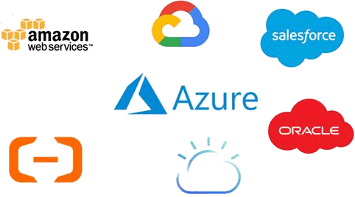
Open Source
Solutions for SMEs
Focus: The MEAN Stack – Remote Access
Applications must be hosted in the cloud to be accessible from any part of the world.
Cloud service providers offer Infrastructure as a Service (IaaS) or Software as a Service (Saas) solutions, that enable the hosting of applications on the internet, from development stage ,through staging to final deployment .
The database server must be hosted online through either the same cloud services provider or a separate database hosting service.
Git

Slide 17

Open Source
Solutions for SMEs
Focus: The MEAN Stack – Productivity
The single most important contributor to productivity when using a software stack, is the single and uniform skill set required for all the members of the team.
For the MEAN stack, a good knowledge of JavaScript is the fundamental requirement for both Frontend and Backend developers.
No retraining in the use of new disparate tools or technologies required
Increases developer confidence, expertise and morale
Builds sustainable and versatile developer teams
Leads to better products
Rapid product delivery

Slide 18
Open Source
Solutions for SMEs
Focus: The MEAN Stack – Community
The individual components of the MEAN stack are industry standards, supported by established organisations, which will not be going away anytime soon.
All products are fully documented on their corresponding website
The worldwide user-base also forms a community providing support for other users.
Solutions to most issues encountered by users, will always be found by a quick search on the internet
Various books and computer-based-training tools abound, to teach the best use methods for all the products

Slide 19
Open Source
Solutions for SMEs
Focus: The MEAN Stack – Software Redistribution
A Git repository is the hub for software redistribution.
A MEAN stack project consists of two separate modules, the frontend and the backend, each configured and installed separately according to the specifications in their corresponding package.json files.
When an application is deployed, all the required dependencies specified in the package.json file , are generated by the server, from the internet.
For distribution, only the source code which includes the package .json file is shared as a compressed file, or simply uploaded to a Git repository for downloading.
The dependencies needed for the application to run, are regenerated whenever the source code is re-installed at different locations, provided the current versions of these dependencies are still compatible with those specified in the package.json file.

Slide 20
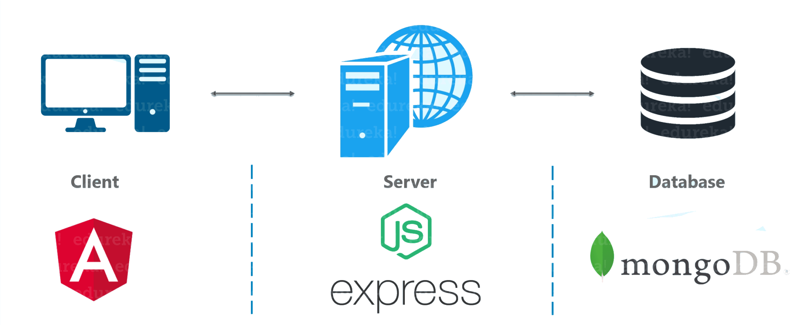
Open Source
Solutions for SMEs
Focus: The MEAN Stack – Software Redistribution
A Git repository is the hub for software redistribution.
5. If there is a problem with any version of the dependencies in the
package.json files, the source code will need to be debugged.
6. The database server must be provisioned and configured separately for each installation.

Slide 21
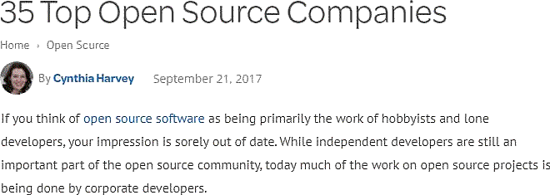
Open Source
Solutions for SMEs
Open Source: Use case - 1
See full list here:
Datamation.com

Slide 22
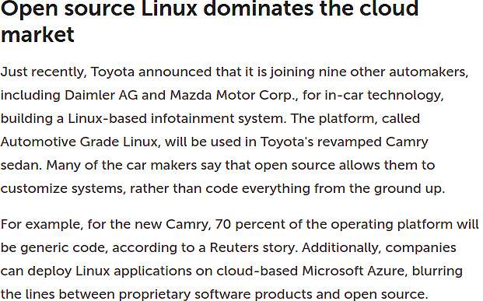
Open Source
Solutions for SMEs
Open Source: Use case - 2
Source:
infoworld.com

Slide 23

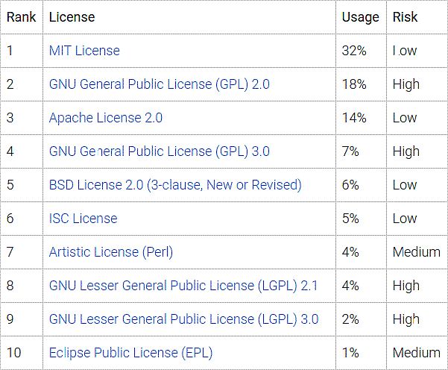
Open Source
Solutions for SMEs
Open Source: Licenses Types - 1
Source:
Synopsis.com

Slide 24
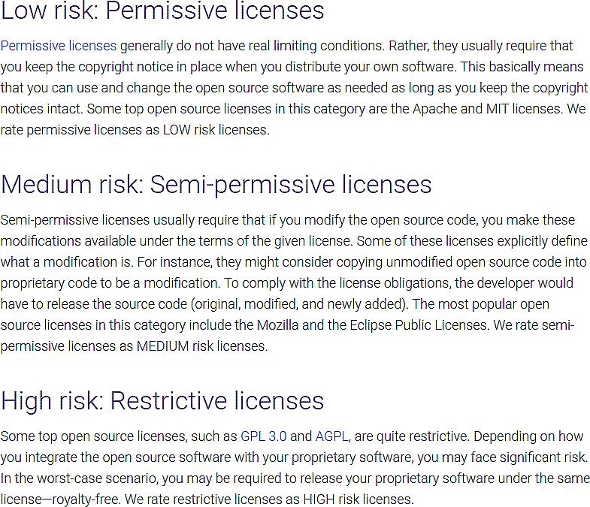
Open Source
Solutions for SMEs
Open Source: Licenses Types - 2
Source:
Synopsis.com

Slide 25
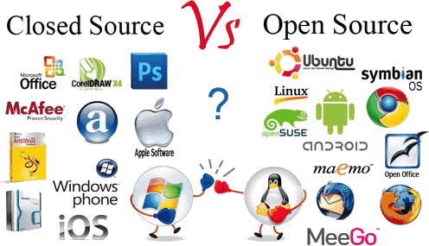
Open Source
Solutions for SMEs
Thank you for listening

